Slide 1
ITSC 302: Web Application Security
Module 1: Mapping the Application

Slide 2
Table of Contents
Review
Textbook Readings
Mapping the Web Application
Web Crawler/Spider
Hidden Content
Functional Paths
Hidden Parameters
Analyzing the Web Application
User Input Entry Points
Server-Side Technologies
Server-Side Functionality
Attack Surface
Self-Test Questions

Slide 3
Review
Intro
Course Grading
Communication / Attendance
Textbook Readings
Definitions
Web App Sec – Core Security Problem
Security Perimeter – Attack Surface
HTTP Methods (GET-POST-etc)
Header / Cookies / Response Status Code
Proxy Servers
Web Server Technologies
Character Encoding

Slide 4
Textbook Readings
Chapter 4

Slide 5
Mapping the Web Application
Reconnaissance and scanning
Gather and examine data on the web app
Analyze attack surface
Enumerate content and functionality
Observe behaviour
Examine security mechanisms
Investigate technologies used

Slide 6
Web Crawler/Spider
Used to index (spider) the contents of a website
Find all links recursively
Submit HTML forms to trace through
Parse scripts to find URLs
Does not always find everything
Dynamic content
Pre-compiled objects
Cannot evade the logout button and basic security measures
Notes:
Robots exclusion standard (robots.txt) – used to tell web crawlers/robots which areas of the website to avoid and not scan. What would you use this for?

Slide 7
User-Directed Spidering
Manually navigate the web app
A tool monitors all requests and responses to map the app using URLs from the browser
User can avoid problems with automated spiders
Make sure all input is valid
Re-activate session if terminated
More complete indexing can be achieved

Slide 8
Hidden Content
Intentionally or unintentionally hidden from web app
Or content is accessible to different user roles
Brute-force: guess using every common name
e.g. About, FAQ, accounts, CRUD
Infer from content: identify naming convention
Cached/archived: by Google or archive.org
Tech forums: Q&A published by developers
Web server: bugs, defaults, third-party software
Notes:
CRUD = Create, read, update and delete are the 4 basic operations on databases.

Slide 9
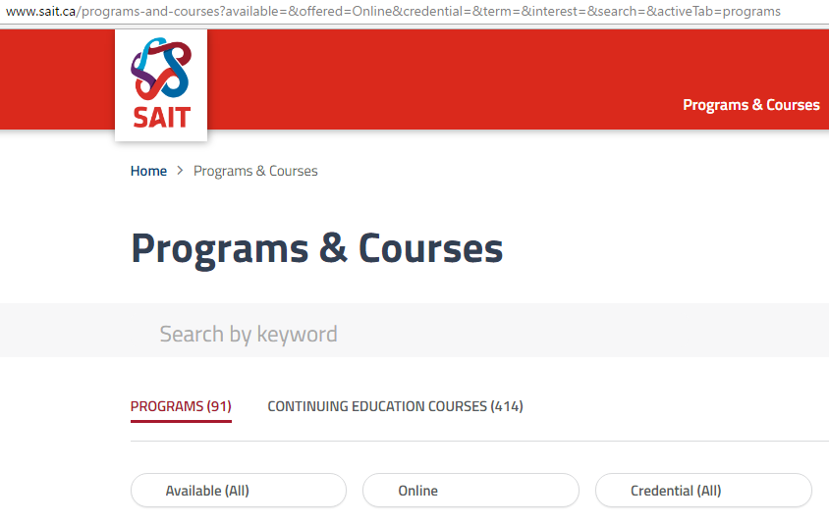

Functional Paths
Based on functionalities instead of pages
Some web apps use the same URL for multiple functions
Action based on parameters in request
Figure 1: Same Page with Different Filters
© 2017, Southern Alberta Institute of Technology, http://www.sait.ca/programs-and-courses
Notes:
Note: Same page with different parameters to define filters.
http://www.sait.ca/programs-and-courses?available=&offered=Online&credential=&term=&interest=&search=&activeTab=programs
http://www.sait.ca/programs-and-courses?available=&offered=Classroom&credential=&term=&interest=&search=&activeTab=programs

Slide 10
Hidden Parameters
Parameters that can be used but not published
Usually for testing/debugging
Or to access undisclosed areas of the web app
Manually add common parameter names and values
e.g., debug=true
If using a third-party component, can look up the API

Slide 11
Analyzing the Web Application
Not just content and core functionality
Error messages, logs
Redirects
Security (session management, access control and authentication including support such as changing password or recovery)
User input processing (URL, query strings, POST data, cookies)
Client technologies (forms, scripts, cookies, other components like applets or Flash)
Server technologies (static and dynamic pages, SSL, web server software, database, email)
Anything else that can give you info on internal structure

Slide 12
User Input Entry Points
URL file paths
Parameters in the query string (after the ? marker)
Parameters in the body of the request
HTTP headers
Especially User-Agent, Referer, Accept, Accept-Language and Host
Cookies
Out-of-band channels (outside of the web app itself)
Retrieving data from another server (e.g., email, HTTP)
Non-browser interfaces (e.g., mobile apps)

Slide 13
Server-Side Technologies
Banner grabbing
HTTP fingerprinting
File extensions
e.g., .asp, .jsp, .cfm, .php, .pl, .py
Directory names
e.g., servlets, pls, cfdocs, rails
Session tokens
e.g., JSESSIONID, ASPSESSIONID, PHPSESSID
Third-party code

Slide 14
Server-Side Functionality
Dissecting requests
e.g., https://wahh-app.com/calendar.jsp?name =new%20applicants&isExpired=0&startDate=22 %2F09%2F2010&endDate=22%2F03%2F2011& OrderBy=name
Extrapolating application behaviour
Common code or design
Isolating unique application behaviour
Added functionalities, bug fixes/patches

Slide 15
Attack Surface (1 of 3)
Client-side validation (may not be done on server side)
Database interaction (SQL injection)
File upload/download (path traversal, stored XSS)
User data display (XSS)
Redirects (redirection/header injection)
Social networks (enumerate user names, stored XSS)
Login (enumerate user names, password cracking)
Multi-stage login (logic flaws)

Slide 16
Attack Surface (2 of 3)
Sessions (predictable or insecure tokens)
Access controls (privilege escalation)
User impersonation (privilege escalation)
Clear-text communication (session hijacking, capture credentials/sensitive data)
Off-site links (query string parameters leaked in Referer header)
External systems (inherited sessions or access controls)

Slide 17
Attack Surface (3 of 3)
Error messages (information leaks)
Email (email/command injection)
Native code (buffer overflows)
Third-party components (known vulnerabilities)
Web server software (common configuration weaknesses, known bugs)

Slide 18
Self-Test Questions
Answer these questions from the textbook:
Chapter 4 – all
Check the answers online:
Chapter 4 (mdsec.net/wahh/answers2e.html#c4)

Slide 19
© 2017, Southern Alberta Institute of Technology. All rights reserved.
This publication and materials herein are protected by applicable intellectual property laws. Unauthorized reproduction and distribution of this publication in whole or part is prohibited.
For more information, contact:
Director, Centre for Instructional Technology and Development
Southern Alberta Institute of Technology
1301 16 Ave. N.W., Calgary, AB T2M 0L4

